Slide 1

Project G.O.A.T
Team name: Mean Green Solutions
Members: Albert Kileo, Jack Follett, Jesus Chavez
Project name: Project G.O.A.T
Client: Clean Chickens and Co. LLC, Rebecca Wierschke

Slide 2
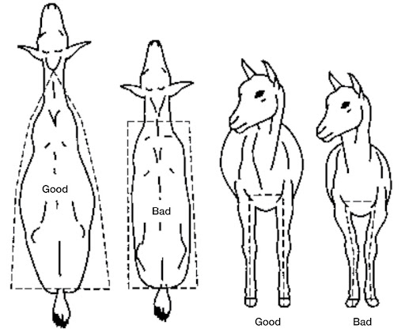
Overview of Project Purpose
The Goat Observation and Assessment Technology (G.O.A.T) project aims to address the absence of a grading system for goat livestock in the U.S. using advanced image recognition and database management, the system will:
Automate goat grading and pricing based on image analysis.
Enable traceability for origin tracking, food security, and recalls.
Improve operational efficiency and standardize carcass selection.

Slide 3
Summary of key design features of the system
Software Features:
Image Gathering and Recognition: Integration with cameras for multi-angle images, processed using AI to assign grades and prices based on goat quality.
Database Management: A structured SQL database for tracking grading data, goat origin, weight, and pricing.
User-Friendly Interface: Simplified UI for workers to input breeder/barcode information, manage images, and access database records.
Hardware Features:
High-quality cameras connected to the system to capture precise images.
Secure, isolated main computer setup to protect from industrial contamination.
Scalable storage solution to accommodate future data growth.

Slide 4
Technical challenges and Resolutions
Challenges:
Image Recognition Accuracy: Differentiating subtle features in goat grading.
Resolution: Leveraged Python-based AI models trained with labeled datasets for precise identification.
Hardware Selection: Ensuring cameras can handle industrial conditions.
Resolution: Selected durable cameras with high resolution and reliable wired connectivity.

Slide 5
Non-technical challenges and Resolutions
Challenge: Coordinating schedules among team members and client with different commitments
Resolution in Progress: Implementing bi-weekly status meetings with all relevant members.
Challenge: Waiting on camera to be delivered after being mistakenly delivered to wrong address
Resolution in Progress: Contact camera delivery service customer support to get a hold of camera
Challenge: Limited Team size, to split work/less ideas to pull
Resolution in Progress: Task Prioritization and work Delegation, use other resources such as prof, internet, similar past project solutions

Slide 6
New skills developed ( technical and non-technical)
Technical Skills:
AI and machine learning for image recognition.
Hardware-software integration for industrial applications.
Non-Technical Skills:
Client communication and project management.
Problem-solving under constraints.
Documentation and training material preparation.
Explain IT terms to non technical users.

Slide 7
Lessons learned
Collaboration is Key: Effective teamwork and communication were critical to navigating both technical and non-technical challenges.
Flexibility is Essential: Unexpected constraints required adaptability and creative problem-solving to meet goals.
Clear Communication: who does what when how
Good Team Work: Share work, offer help others if needed
Interpersonal communication: Explaining IT concepts to non technical users

